Slide 1
Organizational Overview

Slide 2
PureView Health Center
Mission Statement
“To provide comprehensive quality healthcare with comfort.”

Slide 3
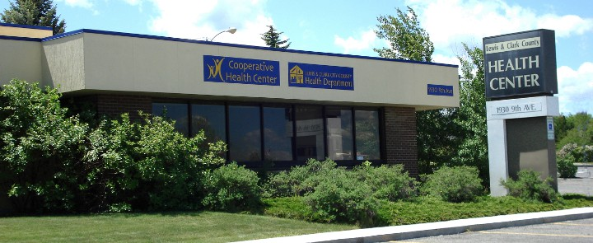
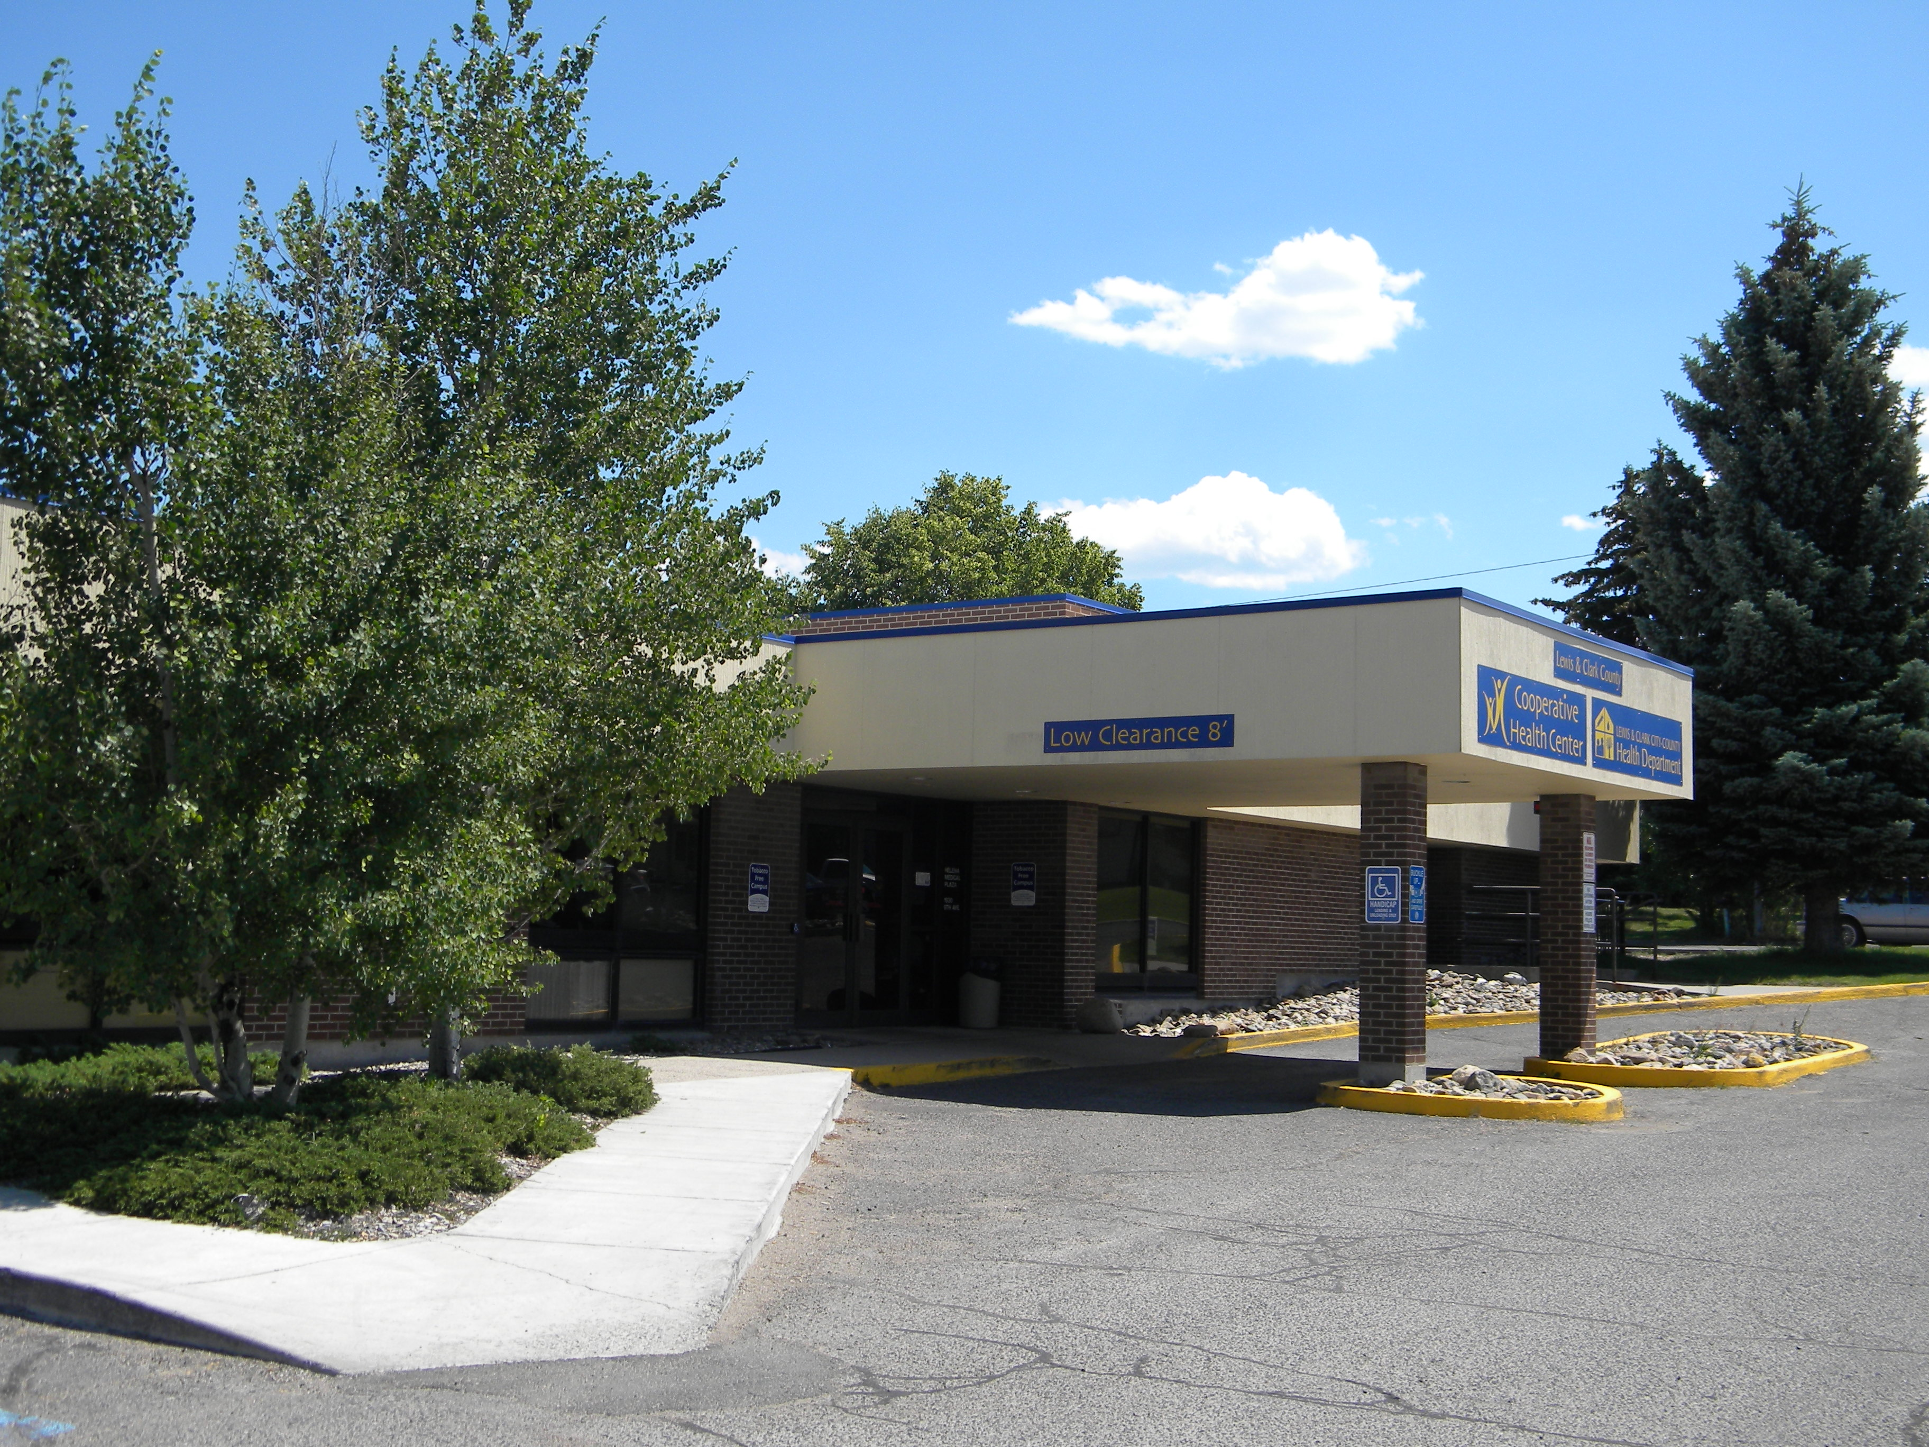

Slide 4
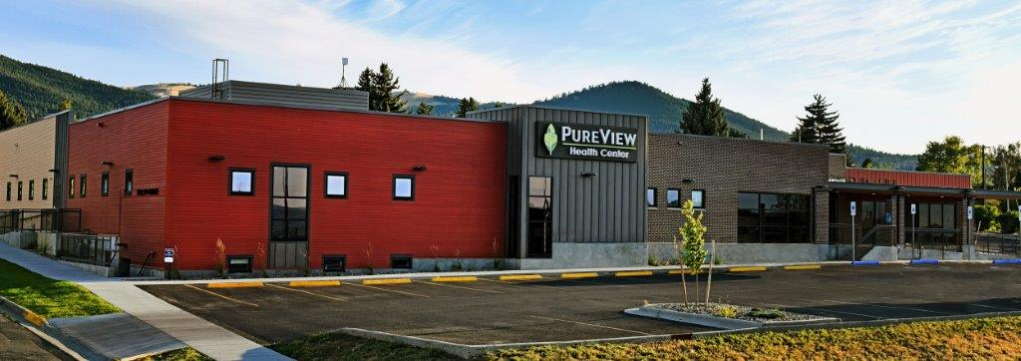

Slide 5
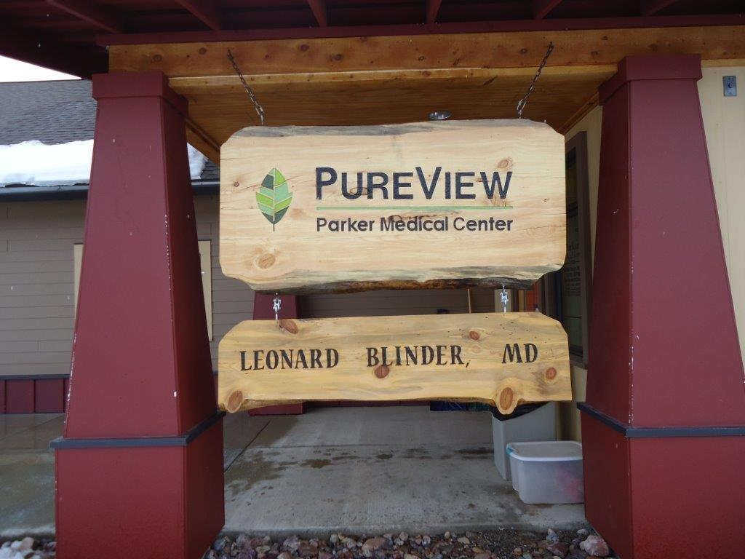
Overview of PureView Health Center
Four sites:
  Helena Main Site
  God’s Love: Healthcare for the Homeless
  East Helena Clinic
  Lincoln, MT: Parker Medical Center

Slide 6
Overview of PureView Health Center
Comprehensive healthcare:
  Medical
    9 Primary Care Providers: 4 Physicians, 1 Physician Assistant, 4 Family Nurse Practitioners
    Family medicine
    On-site lab services
    All ages
    Acute and chronic disease diagnosis and management
    Diabetes education
    Prevention and wellness education
    Case management and resource coordination
    Referrals to specialists
    Assistance in enrolling in Affordable Care Act and Medicaid Expansion

Slide 7
Overview of PureView Health Center
Comprehensive healthcare:
  Dental
    3 Dentists, 2 Hygienists, 3 Dental Assistants
    Exams, X-rays, Hygiene
    All ages
    Emergency and routine care
      Fillings, extractions, selective root canals
    Denture repair, adjustment and reline
    Biopsies
    Referrals to specialists
    Orthopedic and Cardiac dental clearance

Slide 8
Overview of PureView Health Center
Comprehensive healthcare:
  Behavioral Health (Mental Health)*
    2 Psychiatric Nurse Practitioners, 1 Licensed Clinical Social Worker, .5 Pediatric LCSW, 1 Licensed Addiction Counselor, 1 Case Manager
    Mental health services
    Counseling and behavioral medicine
    Individual psycho therapy
    Addiction counseling and treatment
    Case management
    Resource coordination
    Patient education
  *We accept outside referrals to our behavioral health services, but they must have a primary care provider

Slide 9
Overview of PureView Health Center
Comprehensive healthcare:
  Pharmacy
    Pharmaceuticals at a very discounted rate
    Fully stocked pharmacy
    Option to have refills delivered or mailed to your home

Slide 10
Overview of PureView Health Center
  Medication Assisted Treatment (MAT) for Opioid Use Disorders

Slide 11
Overview of PureView Health Center
Comprehensive healthcare:
  Patient Portal:
    Via computer or smartphone you can:
      Access your patient records
      View lab results
      Request refills
      Ask your provider a question

Slide 12
Benefits to Patients of PureView Health Center
Same Day appointments with preferred provider
Walk-in morning appointments for established patients
Sliding Fee Scale
Bill all insurances (including Medicaid, Medicare and Tricare)
Competitive prices with great quality care
Integrated care – medical, dental and mental health in one building

Slide 13
Benefits to Patients of PureView Health Center
Patient Centered Medical Home Level 3
  Highest level of recognition
  Requires us to meet/exceed several standards in healthcare
    Coordinating overall care and referring to specialists when needed
    Providing same day appointments
    Setting goals and treatment plans at every appointment
    Proactive preventive care (letting patients know when they’re due for screenings, immunizations and tests)

Slide 14
Important Information about PureView Health Center
Anyone who is eligible for the sliding fee scale may apply to be on the SFS
Walk-In visits are for anyone
Behavioral Health is an integrated service with primary care, so a referral from a primary care provider is needed.

Slide 15
Contact Information
Jill-Marie Steeley
Executive Director
(406) 457-8956 Direct Line
jsteeley@lccountymt.gov
PureView Health Center
(406) 457-0000
www.pureviewhealthcenter.org

Slide 16
Presentation Property of
© 2015

